Slide 1
Alzheimer’s Dataset
https://www.kaggle.com/datasets/tourist55/alzheimers-dataset-4-class-of-images

Slide 2
About the dataset
Link : https://www.kaggle.com/datasets/tourist55/alzheimers-dataset-4-class-of-images
There are a total of 6400 files in the collection.
Data Distribution: Training and testing sets of the folders are separated.
The total images in the training set(5121). In which Mild Demented(717), Moderate Demented(52), Non Demented(2560), and Very Mild Demented(1792).
The total images in the testing set(1279). In which Mild Demented(179), Moderate Demented(12), Non Demented(640), and Very Mild Demented(448).

Slide 3
Data Preparation
Loading Data: The `cv2.imread()` method in OpenCV is used to load images from the paths.
Data Augmentation: The `ImageDataGenerator` from Keras is used to apply augmentation techniques. Rotation, changing width and height, shearing, zooming, and horizontal flipping are the methods used.
Data splitting: Since my testing directory does not have enough evidence to perform well. So adding all images and then splitting them all allows us to create a unified dataset which helps the model to understand the data and perform well on unseen(testing) data.

Slide 4
Model Architecture Overview
Convolutional Layer: 32 filters, kernel size (3, 3), ReLU activation.
Extracts features like edges, textures, and patterns.
Max Pooling Layer: Pool size (2, 2).
Reduces spatial dimensions, aids computational efficiency.
Flatten Layer: Reshapes output for connection to dense layers.
Dense Layer (Hidden): 256 neurons, ReLU activation.
Learns complex patterns and relationships.

Slide 5
Model Architecture Overview conti..
Dropout Layer: Dropout rate 0.2.
Prevents overfitting by randomly dropping neurons.
Output Dense Layer: 4 neurons, softmax activation.
Outputs probabilities for Alzheimer's disease stages.
Activation: ReLU used for non-linearity.
Optimizer: Adam optimizer for parameter optimization.
Total 6-layer architecture.

Slide 6
Hyperparameter tuning
Using GridSearchCV to Optimize Hyperparameters: The scikit-learn GridSearchCV function is used to systematically tune the hyperparameters.
Epochs, dropout rate, optimizer, and L2 regularization are the parameters.
Grid of parameters:
Epochs: [20, 30, 50, 100]
Dropout rate: [0.2, 0.5]
Optimizer: ['adam', 'rmsprop']
L2 regularization: [0.1, 0.01, 0.001, 0.0001]
Best Parameters after tuning : 0.930862 using {'dropout_rate': 0.2, 'epochs': 100, 'l2_reg': 0.0001, 'optimizer': 'adam'}

Slide 7
Best Model Performance
Used the same model with 6-layer architecture along with the best parameters used L2 regularization to prevent overfitting of the model.
The results of the training and testing accuracies of the model using best parameters are:
Best Epoch: 55
Best Training Accuracy: 0.990429699420929
Corresponding Testing Accuracy: 0.977343738079071

Slide 8
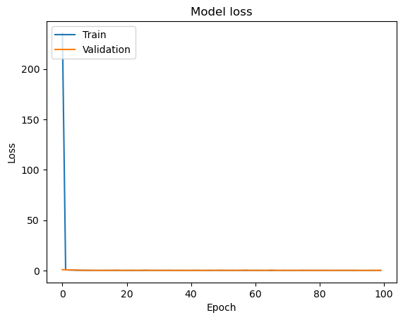
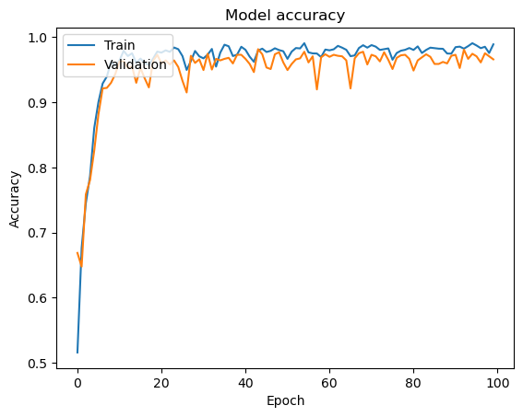
Loss and Accuracy Curves

Slide 9
Conclusion
The CNN model showed good performance, achieving 97.73% validation accuracy and 99.04% training accuracy.
These findings show that the model is capable of correctly identifying the various phases of Alzheimer's disease.
To improve accuracy and generalization, future improvements can include evaluating different designs and regularization strategies.

